Slide 1
EDABA
Lecture 1

Slide 2
EDABA
Organizational issues

Slide 3
EDABA
Lectures
Labs
Classes

Slide 4
EDABA
Lectures - every Thursday 10:15, room 6
Labs
Laboratory 101 (in USOS), Mondays at 12:15, odd weeks Start 13.03.2023
Laboratory 102 (in USOS) Mondays at 12:15, - even weeks Starts 20.03.2023
Laboratory 103 (in USOS) Thursday, at 8:30, - even weeks Start at 23.03.2023

Slide 5
EDABA
Tutorials
Tutorial T101 Thursday, at 8:30, even weeks - students from L101 and L102 only, Start 09.03.20223, 8:30
Tutorial T102 Thursday, at 8:30, odd weeks - students from L103 (obligatory) and (either L101 or L102); Start 16.03.2023, 8:30

Slide 6
EDABA
If pandemia will not repeat, everything will be run in real
Otherwise at a given point we may move to on-line on zoom

Slide 7
EDABA team
Lectures: Prof. Henryk Rybinski
henryk.rybinski@pw.edu.pl
Classes: dr Marek Kozlowski
m.kozlowski@ii.pw.edu.pl
markozlow@gmail.com

Slide 8
EDABA team
Labs:
Dr Grzegorz Protaziuk
Grzegorz.protaziuk@pw.edu.pl
Dr Kamil Zbikowski
Kamil.Zbikowski@pw.edu.pl
Dr Robert Bembenik
robert.Bembenik@pw.edu.pl

Slide 9
EDABA
Lectures are not obligatory but strongly recommended
Labs are obligatory!
Classes are obligatory!

Slide 10
How to pass EDABA
You will have notes from:
2 tests
1st midterm (SQL)
2nd at the end of semester
Final note from labs (average)

Slide 11
Exams
If you
pass 1st test and have at least the note 3,5
have the note 4 or higher (good) from the 2nd test
Have the note 4 or higher (good) from the lab
then you don’t have to pass the exam, and the final note is the average from test2 and LAB

Slide 12
Exams
Otherwise, if you don’t pass lab
then you don’t pass EDABA

Slide 13
Exams
Otherwise, if you have positive note from lab and positive note from exam
The final note is the average from lab and exam if both are ≥ 4
The final note is min(L, E) if any of the notes, L, E is less then 4

Slide 14
Literature
Literature
Elmasri, Navathe:, Fundamentals of Database Systems
Ullman J. Principles of Database and Knowledge Base Systems
E. Date: Introduction to Database Systems
H. Garcia-Molina, J. Ullman, J. Widom: Database Systems: The Complete Book

Slide 15
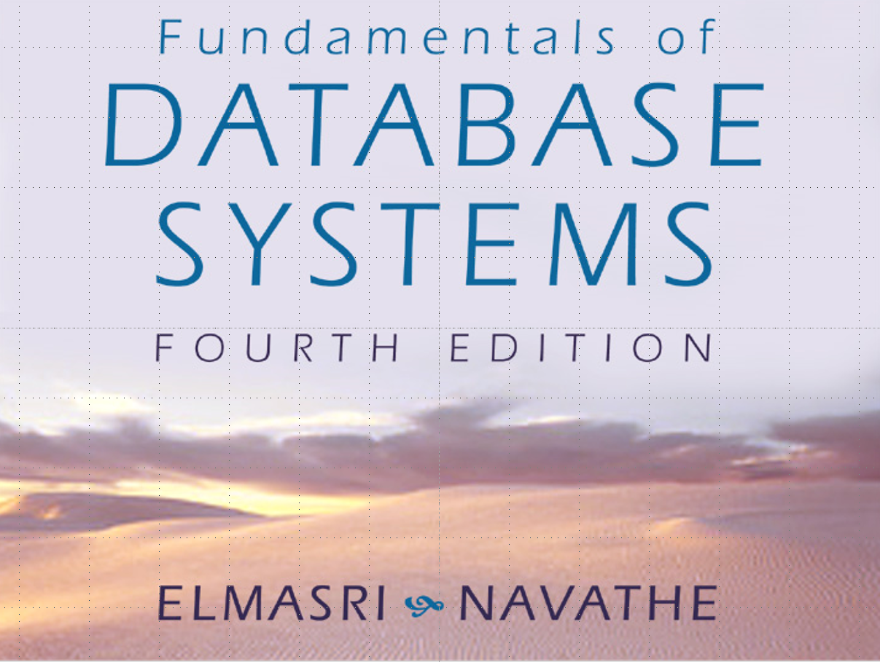
The main materials come from

Slide 16
Contents
Databases – a bit of history
Introduction to basic concepts
Data models
Entity-Relationship diagrams

Slide 17
Contents
Relational database:
Relational algebra
SQL
Design theory
Physical level of the databases
Transactions in databases

Slide 18
So let us start
A brief history

Slide 19
History (a summary)
End of 50ties - COBOL, file system RAMAC - 1959
1961 IDS by Bachman (General Electric)
1969 RDF of Rand Coproration (very relational approach to data, but closer to logic (lack of relational algebra)
1970 Codd’s paper
1971 CODASYL

Slide 20
History (a summary)
1975 ACM SIGMOD has been launched
1975 1st VLDB conference
1976 Chen’s paper - E-R; first commercial relational databases: System R (IBM) tranformed to DB2 ,
INGRES Berkley Univ., then INGRES Inc.
Socrates (France), ADABAS
1983 ANSI/SPARC counts more than 100 relational DBMS

Slide 21
Change of mind in understanding the computer applications
program centered view
to data centered view

Slide 22
Change of mind in understanding the computer applications
program centered view
Program
Input data
Output data

Slide 23
Change of mind in understanding the computer applications
data centered view
P₃
P₂
P₄
P₁
Database
P₅
P_{n}
P₆
…

Slide 24
Facts
Annual sales of database products in the 1990s: $ 10 billion (US only); dynamics approx. 35% / 1 year
Annual sales of information services in the US $ -10 billion
nowadays applications:
Big Data,
e-commerce
Multimedia databases (YouTube)
Search engines (gogle)
specialized scientific databases

Slide 25
Facts
In 2007, sales of business intelligence tools alone reached $ 15 billion USD

Slide 26
Mile stones
Before relational database 1950ties-1970
Relational database 1970-till now
Transactions mid of 70-ties of 20 century
Distributed system (80-ties)
Logical databases (since mid of 70ties mainly R & D, since 2000 … semantic web)
Big data
Notes:
End of 50ties - COBOL, file syste RAMAC - 1959
1961 IDS Bachmana (General Electric)
1969 RDF of Rand Coproration (very relational approach to data, but closer to logic (lack of relational algebra)
1970 Codd’s paper
1971 CODASYL
1975 ACM SIGMOD has been launched
1975 1st VLDB conference
1976 Chen’s paper - E-R; first commercial relational databases: System R (IBM) tranformed to DB2 ,
INGRES Berkley Univ., then INGRES Inc.
Socrates (France), ADABAS
1983 ANSI/SPARC counts more than 100 relational DBMS

Slide 27
Mile stones
Before relational database 1950ties-1970
FORTRAN solutions from 50-ties of the 20 century
COBOL programming language 1960, 1968
Generalized Information system mid 60-ties
CODASYL - late 60-ties till early 80-ties
Hierarchical databases - as above
Notes:
End of 50ties - COBOL, file syste RAMAC - 1959
1961 IDS Bachmana (General Electric)
1969 RDF of Rand Coproration (very relational approach to data, but closer to logic (lack of relational algebra)
1970 Codd’s paper
1971 CODASYL
1975 ACM SIGMOD has been launched
1975 1st VLDB conference
1976 Chen’s paper - E-R; first commercial relational databases: System R (IBM) tranformed to DB2 ,
INGRES Berkley Univ., then INGRES Inc.
Socrates (France), ADABAS
1983 ANSI/SPARC counts more than 100 relational DBMS

Slide 28
Mile stones
In 1970 a paper in Comm. of ACM by E Codd is published, and since then we can observe a dynamic development of the relational databases
Notes:
Koniec lat 50 - COBOL, system kartotek RAMAC - 1959
1961 IDS Bachmana (General Electric)
1969 RDF firmy Rand Coproration (bardzo relacyjne podejście, ale bez algebry relacyjnej)
1970 pionierska praca Codda
1971 CODASYL
1975 powstaje ACM SIGMOD
1975 pierwsza konferencja VLDB
1976 artykuł Chena początkujący karierę E-R; pierwsze komercyjne bazy danych: System R (IBM) -póżniej DB2 ,
INGRES Berkley Univ., póżniej INGRES Inc.
Socrates (Francja), ADABAS
1983 przegląd ANSI/SPARC wylicza ponad 100 relacyjnych SBD

Slide 29
Mile stones
Ingres began as a research project at the University of California, Berkeley.
The original code, like that from other projects at Berkeley, was available at minimal cost under a version of the BSD license.
Notes:
Koniec lat 50 - COBOL, system kartotek RAMAC - 1959
1961 IDS Bachmana (General Electric)
1969 RDF firmy Rand Coproration (bardzo relacyjne podejście, ale bez algebry relacyjnej)
1970 pionierska praca Codda
1971 CODASYL
1975 powstaje ACM SIGMOD
1975 pierwsza konferencja VLDB
1976 artykuł Chena początkujący karierę E-R; pierwsze komercyjne bazy danych: System R (IBM) -póżniej DB2 ,
INGRES Berkley Univ., póżniej INGRES Inc.
Socrates (Francja), ADABAS
1983 przegląd ANSI/SPARC wylicza ponad 100 relacyjnych SBD

Slide 30
Mile stones
Following Ingres, a number of commercial database applications have apeared: ORACLE (mid of 80-ties),
Sybase (90-ties),
Microsoft SQL Server
Notes:
Koniec lat 50 - COBOL, system kartotek RAMAC - 1959
1961 IDS Bachmana (General Electric)
1969 RDF firmy Rand Coproration (bardzo relacyjne podejście, ale bez algebry relacyjnej)
1970 pionierska praca Codda
1971 CODASYL
1975 powstaje ACM SIGMOD
1975 pierwsza konferencja VLDB
1976 artykuł Chena początkujący karierę E-R; pierwsze komercyjne bazy danych: System R (IBM) -póżniej DB2 ,
INGRES Berkley Univ., póżniej INGRES Inc.
Socrates (Francja), ADABAS
1983 przegląd ANSI/SPARC wylicza ponad 100 relacyjnych SBD

Slide 31
Conclusions
Database area was one of the most spectacular cases of influencing the industrial development by scientific research
Notes:
Tandem Ltd sprzedaje odporne na błędy systemy przetwarzania tranzakcji na sumę 1 mld$ USA

Slide 32
Conclusions
For example:
When the relational model was first proposed, it was seen as an elegant theoretical construction, on the basis of which you can implement a toy.
The enormous research contribution allowed transform this toy into a commercial product.
Notes:
Tandem Ltd sprzedaje odporne na błędy systemy przetwarzania tranzakcji na sumę 1 mld$ USA

Slide 33
1985-1995
Object Oriented Databases (OODB)
OLAP (On Line Analysis Process)
Data minig (Terradata earned with their products for data mining 500 mln $/yearly)
New products – SYBASE with distributed database solutions

Slide 34
Let us stop at OODB for a while
Genesis
Relational databases seem to be too limited in modeling complex cases
There is a progres in new modeling approaches in AI, but also in software engineering

Slide 35
Object Oriented databases
(motivations)
fitting the database model to the requirements of conceptual modeling
organizing mechanisms for operating on data in programming languages
better control of semantic integrity

Slide 36
Object Oriented databases
Sales of OODB in 1995 were estimated at $ 75 million
Sales dynamics in 1995 was 50% and showed an upward trend
At around year 2000 the development of OODB has stopped;

Slide 37
Object Oriented databases
The commercial RBD suppliers have added "Object" options
The Java coffee package, ORM products have appeared that allow you to use relational databases as if they were object oriented (e.g. HIBERNATE

Slide 38
What next?
Data warehouses
Business Intelligence:
In 2007, sale of business-intelligence tools reached $ 15 Billion USD

Slide 39
What now ?
Global e-commerce
eBay
Amazon
Allegro
….

Slide 40
What now ?
Global search engines for the Internet contents
Yahoo
Google
Bingo

Slide 41
What drives the development of the DB systems development
IT Technology (hardware)
Number of CPU instructions / sec.
the cost of a typical processor
disk memory size / unit cost
main memory size / unit cost
mass storage size
Every 10 years, each of these parameters improves one order of magnitude or more

Slide 42
What drives the development of the DB systems development
Telecommunication
Internet as a means for accessing information resources with the tendency to organize these resources in the form of databases
WWW as a method of communication
New forms of services via www
Internet of things (IoT)

Slide 43
What drives the development of the DB systems development
Software development
Client-server - moving from file server to database server
multimedia
development of operating systems
text databases

Slide 44
What drives the development of the DB systems development
Research
Big data
multimedia
development of operating systems
Natural Language Processing
Means for ubiquitous computing (e.g.smartphones IoT)

Slide 45
What drives the development of the DB systems development
The pressure of the database market
Negative factors
Legacy systems
Economic crises,
1990-94,
Internet bubble 1995-2001,
Financial crisis in 2008
effect: reduction of funds for research

Slide 46
What drives the development of the DB systems development
The pressure of the database market
Positive factors
Information systems & Databases in the strategic research group (Tool & Young report for the White House, 1995)
increased interest in information technology for business (since 2002 very rapid)

Slide 47
Basic concepts
Information system
vs
Data base Management system

Slide 48
Basic concepts
Data Base Management System is a set of tools, which can be used to
design information system
Implement information system
run it

Slide 49
Basic concepts
Actors
Database designers, analysts
Application programmers
Administrators
Users

Slide 50
Basic concepts
Data model
A data model is an abstract model that organizes elements of data and standardizes how they relate to one another and to the properties of real-world entities.
…for instance, a data model allows us to specify that the data element representing a student be composed of a number of other elements which, in turn, represent the family name and year of birth of the student, etc.

Slide 51
Basic concepts
Data models
60-ties of the previous century
hierarchical data model
CODASYL (network)
70-ties and later
Relational
80-ties
Object oriented data model

Slide 52
Basic concepts
Other data models
Graph model
XML model

Slide 53
Example: Data in Graph model
root
Notice a
new kind
of data.
beer
beer
bar
manf
manf
prize
name
A.B.
name
servedAt
year
award
Bud
M’lob
1995
Gold
name
addr
Joe’s
Maple
The beer object
for Bud
The bar object
for Joe’s Bar

Slide 54
Example: an XML Document
A NAME
subobject
<?xml version = “1.0” encoding = “utf-8” ?>
<BARS>
<BAR><NAME>Joe’s Bar</NAME>
<BEER><NAME>Bud</NAME>
<PRICE>2.50</PRICE></BEER>
<BEER><NAME>Miller</NAME>
<PRICE>3.00</PRICE></BEER>
</BAR>
<BAR> …
</BARS>
A BEER
subobject

Slide 55
DTD’s (Document Type Definitions)
A grammatical notation for describing the structure allows use of tags.
Definition form:
<!DOCTYPE <root tag> [
<!ELEMENT <name>(<components>)>
. . . more elements . . .
]>

Slide 56
Example: DTD
A BARS object has
zero or more BAR’s
nested within.
<!DOCTYPE BARS [
<!ELEMENT BARS (BAR*)>
<!ELEMENT BAR (NAME, BEER+)>
<!ELEMENT NAME (#PCDATA)>
<!ELEMENT BEER (NAME, PRICE)>
<!ELEMENT PRICE (#PCDATA)>
]>
A BAR has one
NAME and one
or more BEER
subobjects.
A BEER has a
NAME and a
PRICE.
NAME and PRICE
are HTML text.

Slide 57
Basic concepts
Data model = structure + language
A data model determines:
A language for defining structures: DDL
A language for manipulating structures: DML

Slide 58
Basic concepts
A language for defining structures: DDL
P₃
P₂
P₄
P₁
Database
P₅
P_{n}
P₆
…

Slide 59
Basic concepts
A language for defining structures: DDL
P₃
P₂
P₄
Schema
Written in DDL
P₁
P₅
P_{n}
P₆
…

Slide 60
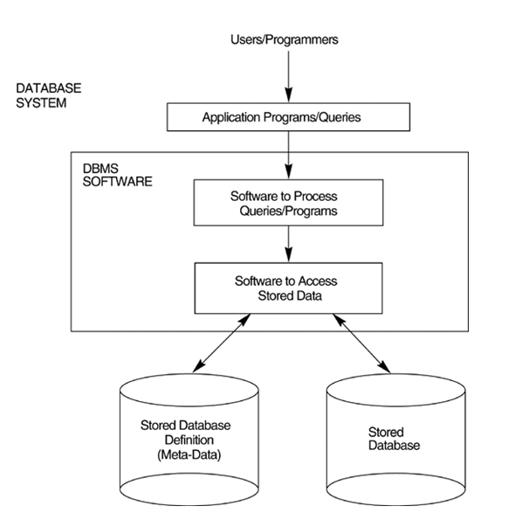
Basic concepts
A language for manipulating structures i.e. DML is used in programs
P₃
P₂
P₄
DML
P₁
DML
Database
P₅
DML
DML
DML
P_{n}
P₆
…

Slide 61
In more detail

Slide 62
Basic concepts
So, we have new concepts
a database schema, which is written in the Data Description Language
application programs, which are writen with the use of Data Manipulation Language

Slide 63
Basic concepts
Schema as a metadata
Database as an instance

Slide 64
Basic concepts
Schema describes general properties of data
These properties reflect the properties of real-world objects, being described by the information system
The properties are sometimes called integrity contraints

Slide 65
Basic concepts
Examples of constraints
In the schema we have to express that:
The age of (every) student must be between 18 and 30
The students on Semester_1 can be registered to the subjects giving no more than 30 ECTS, and the numer of lectures should be > 4
Every student has an Index Number which uniquely identifies him/her

Slide 66
Basic concepts
Database as an instance for a given schema
The database instance should be consistent with a schema.
Subschema, view

Slide 67
Basic concepts
Subschema
For each group of users we have an extraction of the schema, which defines a part of the database structure, relevant to these users needs

Slide 68
Basic concepts
View
View defines new concepts in our schema with the usage of existing concepts, e.g
Given a concept of PARENT we can define MOTHER, FATHER, GRANDPARENT, etc.

